Slide 1

MANUAL ON SETTING UP
SECURITY QUESTION & ANSWER
(SELF-SERVICE)

Slide 2

1. Log In to
your account

Slide 3
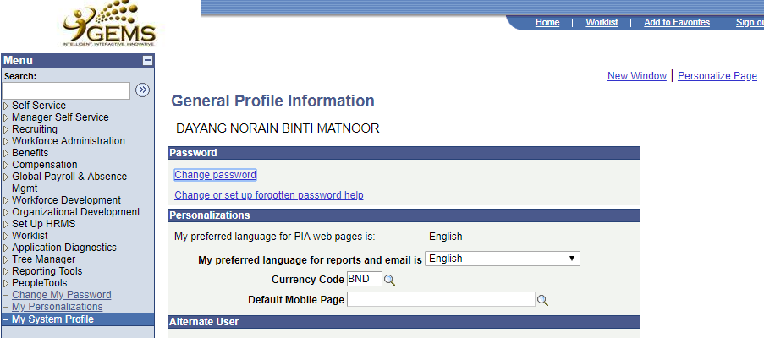
Ali bin Hussin
3. Click Change or Setup forgotten password help
2. Click My System Profile

Slide 4
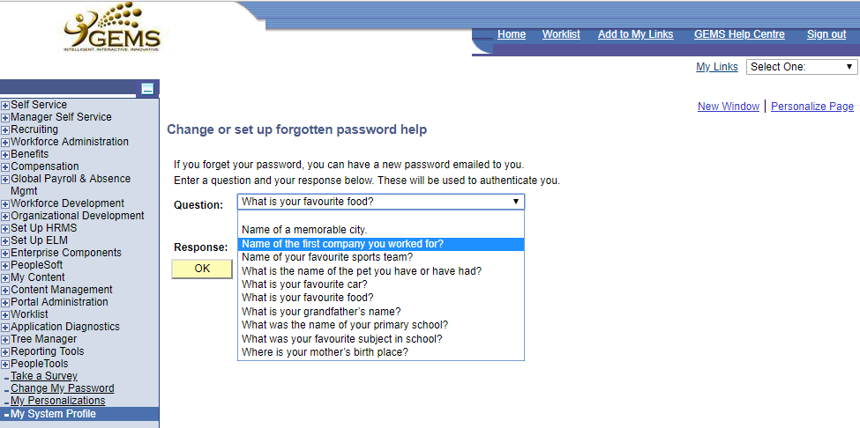
4. Click here to view and choose the available question

Slide 5
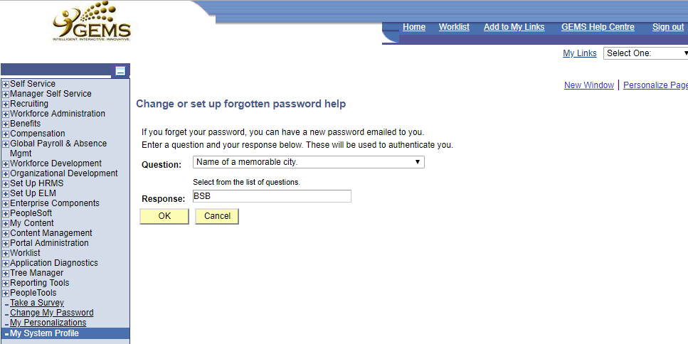
Saved
5. Enter your answer in the space provided
Please make sure changes made are updated and saved
6. Click Ok

Slide 6
MANUAL ON USING
“FORGOT YOUR PASSWORD?”
(SELF-SERVICE)

Slide 7
1. Click Forgot your password?
Forgot your Password?
Can only be use if you have set-up your secret question and asnwer in advance.

Slide 8
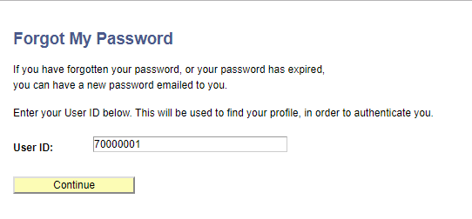
2. Enter your
IC Number
3. Click Continue

Slide 9
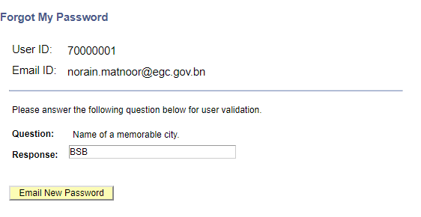
ali.hussin@psd.gov.bn
4. Enter your answer in the space provided
5. Click Email New Password

Slide 10
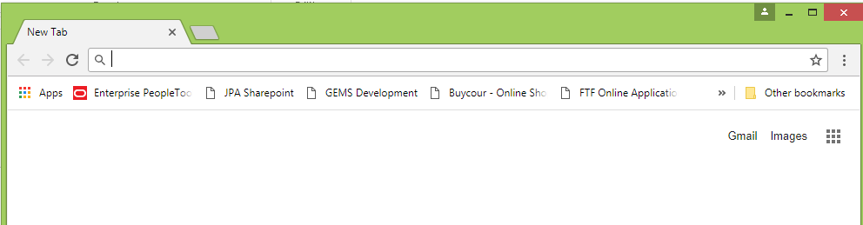
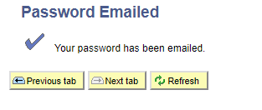
ii. It is suggested to close and reopen a new web browser to log in using the new password provided via email.
i. New Password will be sent through your email. Please check your email.

Slide 11
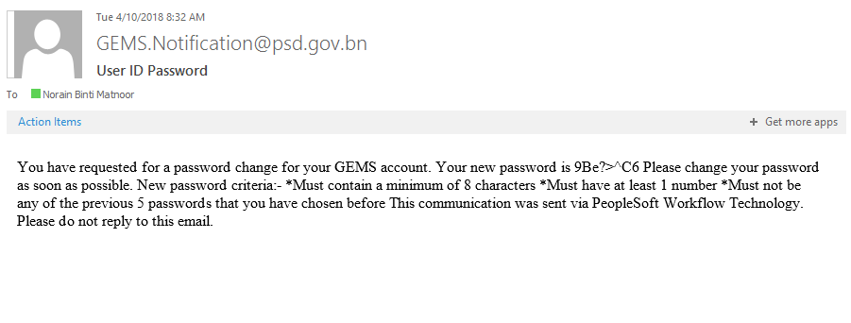
Ali bin Hussin
This is your new password.
You are advised to change your password after you log in using password that are provided via email.

Slide 12
Please make sure that you use a new web browser to log in using the new password provided.
1.Log in to
your account

Slide 13
MANUAL ON UPDATING
“CHANGE PASSWORD”
(SELF-SERVICE)

Slide 14
1. Click My System Profile
Ali bin Hussin
2. Click Change password

